Slide 1
Trees
© 2013 Goodrich, Tamassia, Goldwasser
Trees
Notes:
Trees

Slide 2
Linear Data Structures
Data structures we have studied so far:
  Arrays
  Stacks, queues, and deques
  Singly-linked lists and doubly-linked lists
Common property
  Their visual representation forms a straight line
Trees are nonlinear data structures
  Binary trees: one of the simplest nonlinear data structures

Slide 3
What is a Tree
In computer science, a tree is an abstract model of a hierarchical structure
A tree consists of nodes with a parent-child relation
Applications:
  Organization charts
  File systems
  Programming environments
  Games
Computers”R”Us
Sales
Manufacturing
R&D
US
International
Laptops
Desktops
Europe
Asia
Canada
© 2013 Goodrich, Tamassia, Goldwasser
Trees

Slide 4
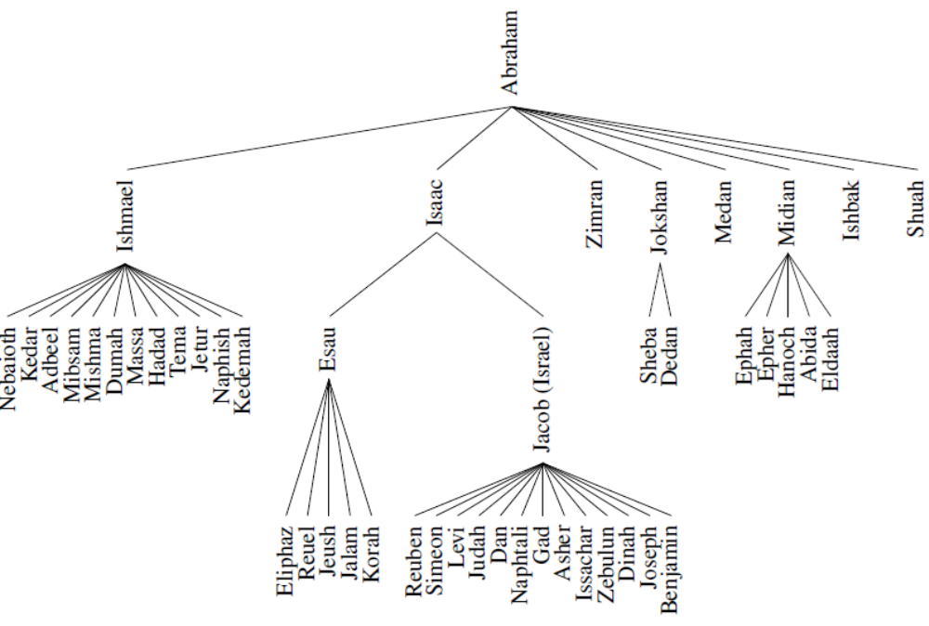
Family Tree
© 2013 Goodrich, Tamassia, Goldwasser
Trees

Slide 5
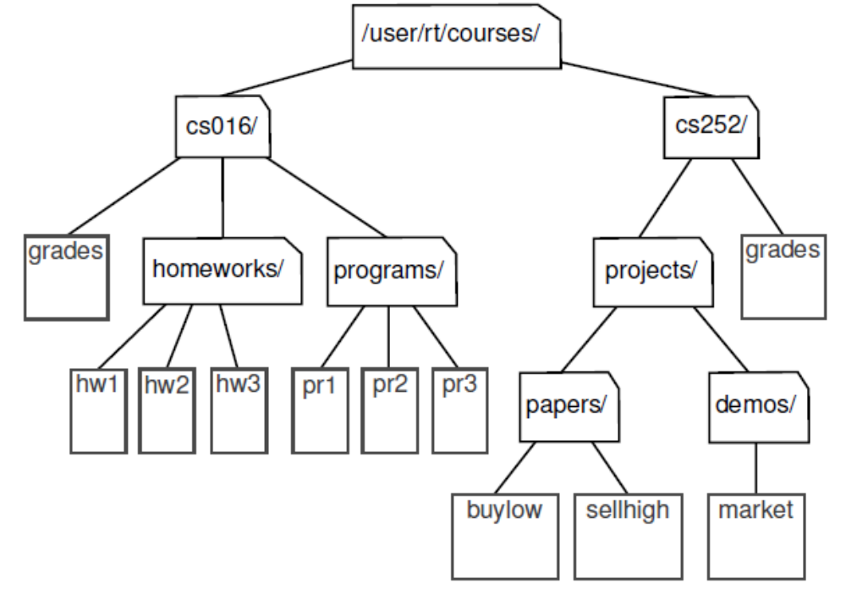
Computer File Systems
© 2013 Goodrich, Tamassia, Goldwasser
Trees
Notes:
Trees

Slide 6
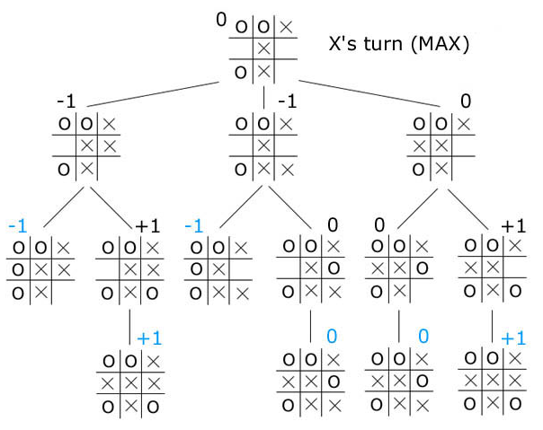
Game tree
Lookahead possible moves in multiple turns between 2 opponents.
Select the most favorable move for X
© 2013 Goodrich, Tamassia, Goldwasser
Trees

Slide 7
Tree Terminology
Root: node without parent (A)
Internal node: node with at least one child (A, B, C, F)
External node (a.k.a. leaf ): node without children (E, I, J, K, G, H, D)
Ancestors of a node: parent, grandparent, grand-grandparent, etc.
Depth of a node: number of ancestors
Height of a tree: maximum depth of any node (3)
Descendant of a node: child, grandchild, grand-grandchild, etc.
Subtree: tree consisting of a node and its descendants
A
subtree
B
C
D
E
F
G
H
I
J
K
© 2013 Goodrich, Tamassia, Goldwasser
Trees
Notes:
Trees

Slide 8
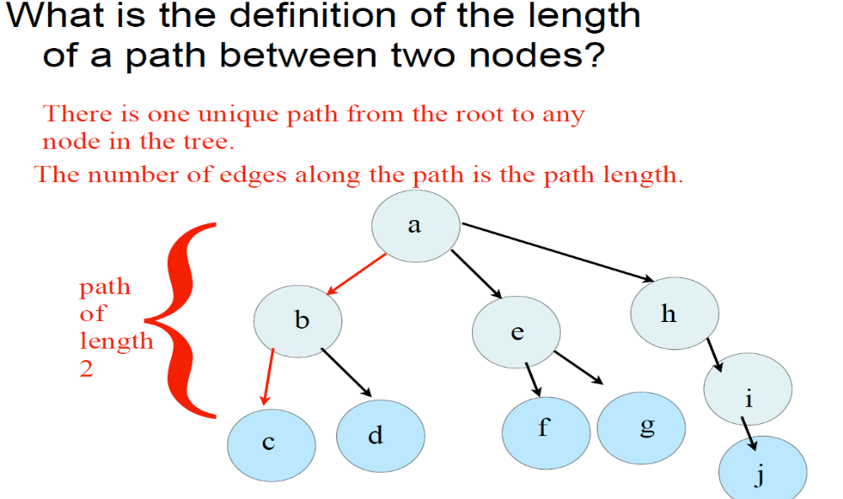
Path between two nodes
© 2013 Goodrich, Tamassia, Goldwasser
Trees

Slide 9
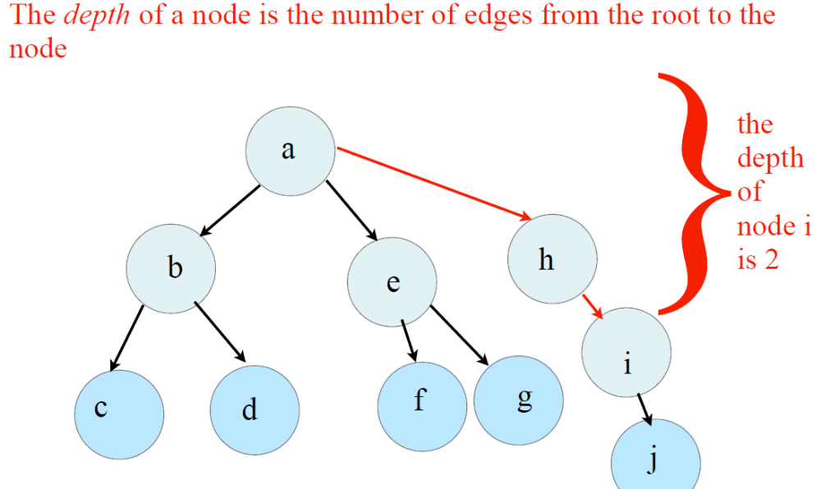
Depth of a Tree
© 2013 Goodrich, Tamassia, Goldwasser
Trees
Notes:
Depth(i) = 0 if node i is root (no parent); otherwise
Depth(i) = 1 + Depth(parent(i))
Trees

Slide 10
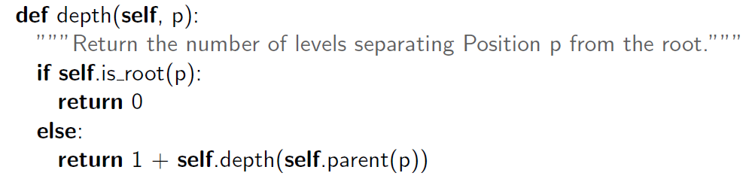
Recursive computation
Base case: At root node, depth is 0
© 2013 Goodrich, Tamassia, Goldwasser
Trees

Slide 11
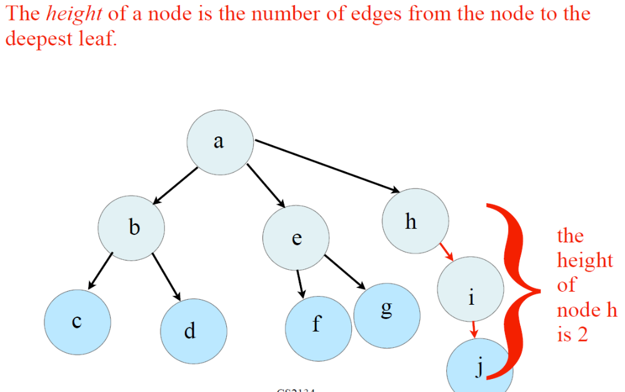
Height of a tree
© 2013 Goodrich, Tamassia, Goldwasser
Trees

Slide 12
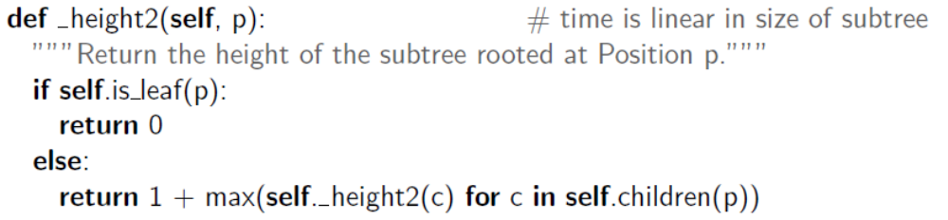
Height of a tree
The height of a position p in a tree T is also defined recursively:
• If p is a leaf, then the height of p is 0.
• Otherwise, the height of p is one more than the maximum of the heights of p’s children.
The height of a nonempty tree T is the height of the root of T.
© 2013 Goodrich, Tamassia, Goldwasser
Trees

Slide 13
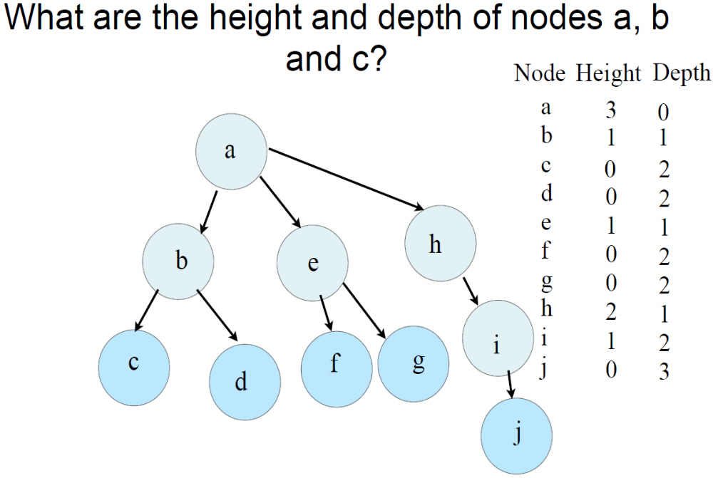
© 2013 Goodrich, Tamassia, Goldwasser
Trees
Notes:
Height of node: the deepest leaf node it can go to. Count number of edges.
Depth of a node: the number of edges it needs to arrive at the root node
Trees

Slide 14
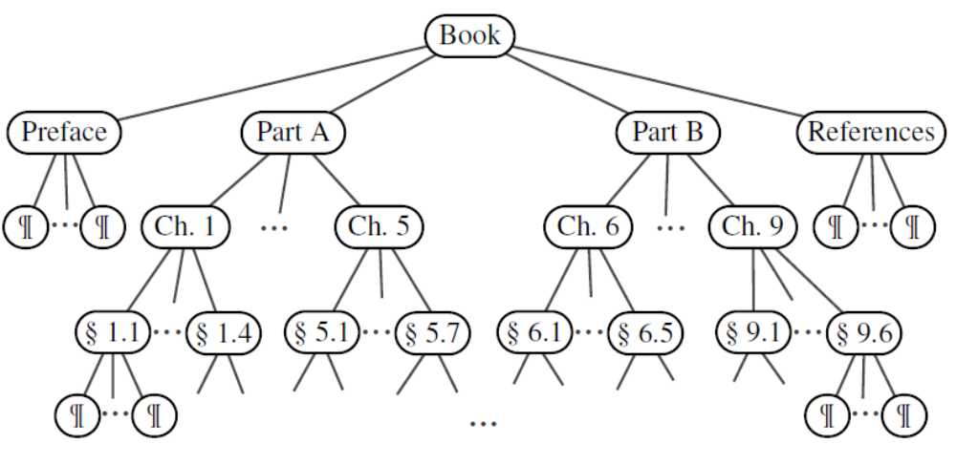
Ordered Trees
A tree is ordered if there is a meaningful linear order among the children of each node
© 2013 Goodrich, Tamassia, Goldwasser
Trees
Notes:
The tree is ordered because Preface (Tree) comes first, followed by (Part A), followed by (Part B) and so on
Trees

Slide 15
Question?
If a tree has n nodes how many edges does it have?
Answer: n-1 edges
© 2013 Goodrich, Tamassia, Goldwasser
Trees
Notes:
Trees

Slide 16
Binary Trees
A binary tree is a tree with the following properties:
  Each internal node has at most two children (exactly two for proper/full binary trees)
  The children of a node are an ordered pair
We call the children of an internal node left child and right child
Alternative recursive definition: a binary tree is either
  a tree consisting of a single node, or
  a tree whose root has an ordered pair of children, each of which is a binary tree
Applications:
  arithmetic expressions
  decision processes
  searching
A
B
C
D
E
F
G
H
I
© 2013 Goodrich, Tamassia, Goldwasser
Trees
Notes:
Trees

Slide 17
Arithmetic Expression Tree
Binary tree associated with an arithmetic expression
  internal nodes: operators
  external nodes: operands
Example: arithmetic expression tree for the expression (2 × (a − 1) + (3 × b))
+
×
×
2
−
3
b
a
1
© 2013 Goodrich, Tamassia, Goldwasser
Trees

Slide 18
Decision Tree
Binary tree associated with a decision process
  internal nodes: questions with yes/no answer
  external nodes: decisions
Example: dining decision
Want a fast meal?
Yes
No
How about coffee?
On expense account?
Yes
No
Yes
No
Starbucks
Spike’s
Al Forno
Café Paragon
© 2013 Goodrich, Tamassia, Goldwasser
Trees
Notes:
Trees

Slide 19
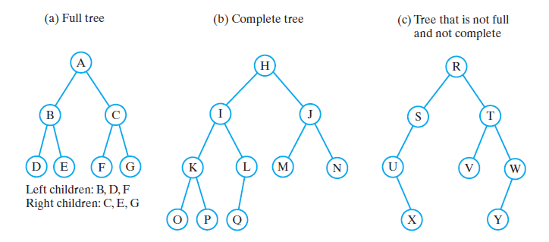
Binary Trees
Three binary trees
Notes:
A complete binary tree is a binary tree in which every level, except possibly the last, is completely filled, and all nodes are as far left as possible.
Trees

Slide 20
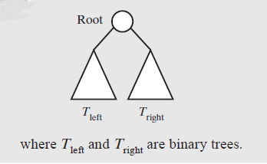
Binary Trees
A binary tree is empty or has the above form

Slide 21
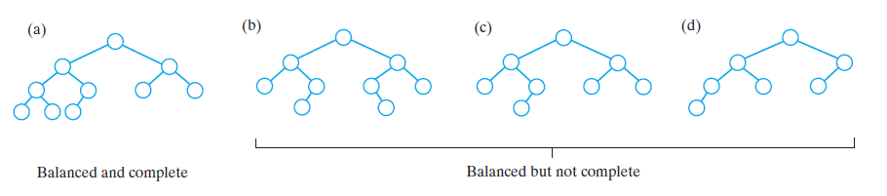
Binary Trees
Some binary trees that are height balanced
Notes:
A balanced binary tree is a binary tree structure in which the left and right subtrees of every node differ in height by no more than 1.
Trees

Slide 22
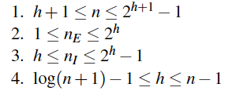
Properties of Binary Trees
Properties:
Notation
  n number of nodes
  n_{e} number of external nodes
  n_{i} number of internal nodes
  h height
h=2 with max # nodes
h=2 with min # nodes
© 2013 Goodrich, Tamassia, Goldwasser
Trees
Notes:
Eq1: Use a skinny tree and balanced tree to create the bound
Eq2: Just compute the number of nodes at the last layer of tree
Eq3: Total number of nodes in a tree = Total number of internal nodes + total number of external nodes (N = Ni + Ne).
Subtract Eq1 with Eq2
Eq4: Rearrange both sides in Eq1
Trees

Slide 23
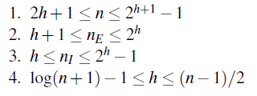
Properties of Proper Binary Trees
A full binary tree (sometimes proper binary tree or 2-tree) is a tree in which every node other than the leaves has two children.
Notation
  n number of nodes
  n_{e} number of external nodes
  n_{i} number of internal nodes
  h height
h=2 with max # nodes
h=2 with min # nodes
© 2013 Goodrich, Tamassia, Goldwasser
Trees
Notes:
Use the skinny proper binary tree to bound the inequalities.
We modify the lower-bound with the skinnest proper binary tree in Eqn 1 and 2. Then we subtract 1 from 2 to obtain Eqn 3. Then we re-arrange Eqn1 and take log(.) to obtain the bounds.
Trees

Slide 24
Traversals of A Tree
Definition
  Visit, or process, each data item exactly once
  Visit can be delayed
    Traversal can pass through a node without processing it
Order of the visits is not unique
First consider traversals of a binary tree
  Somewhat easier to understand
Notes:
Processing example: print the value in a node
Trees

Slide 25
Tree Traversals (Binary Tree)
• pre-order
–visit root
–traverse left subtree
–traverse right subtree
• post-order
–traverse left subtree
–traverse right subtree
–visit root
• in-order
–traverse left subtree
–visit root
–traverse right subtree
• level-order (
–visit root
– traverse level 1 nodes
– traverse level 2 nodes
– -----
– -----
– -----
– traverse last level nodes
* For Proper tree, level order is same as Breadth First Traversal
© 2013 Goodrich, Tamassia, Goldwasser
Trees

Slide 26
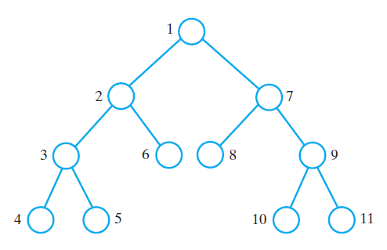
Preorder Traversal (any tree)
A traversal visits the nodes of a tree in a systematic manner
In a preorder traversal, a node is visited before its descendants
Application: print a structured document
Algorithm preOrder(v)
  visit(v)
  for each child w of v
  preorder (w)
Book
Ch 1
Ch 2
Ch 1.1
Ch 1.2
Ch 2.2
Ch 2.1
Ch 1.1.1
Ch 1.1.2
Ch 2.2.1
Ch 2.2.2
© 2013 Goodrich, Tamassia, Goldwasser
Trees

Slide 27
Postorder Traversal (any tree)
In a postorder traversal, a node is visited after its descendants
Application: compute space used by files in a directory and its subdirectories
Each internal node has Sum(.)
over returned values from children
Algorithm postOrder(v)
  for each child w of v
  postOrder (w)
  visit(v)
9
5k + 55k + 1k = 61k
cs16/
8
3
7
homeworks/
programs/
10k+25k+20k=55k
todo.txt
1K
3k+2k=5k
1
2
4
5
6
h1c.doc
3K
h1nc.doc
2K
DDR.java
10K
Stocks.java
25K
Robot.java
20K
© 2013 Goodrich, Tamassia, Goldwasser
Trees

Slide 28
Post-order sum operations
def sum_directory_space(node):
if node.is_leaf():
# we hit a file item. So return the file size
return node.value
# now we are in an internal node
left_size, right_size = 0, 0
if node.left:
# Process the left sub-tree (Recursion here)
left_size = sum_directory_space(node.left)
if node.right:
# Process the right sub-tree (Recursion here)
right_size = sum_directory_space(node.right)
return left_size + right_size
Post-order:
A node finishes processing after all of its child nodes finished processing
© 2013 Goodrich, Tamassia, Goldwasser
Trees

Slide 29
Inorder Traversal (binary tree)
In an inorder traversal a node is visited after its left subtree and before its right subtree
Application: draw a binary tree
  x(v) = inorder rank of v
  y(v) = depth of v
Algorithm inOrder(v)
  if v has a left child
    inOrder (left (v))
  visit(v)
  if v has a right child
    inOrder (right (v))
6
2
8
1
4
7
9
3
5
© 2013 Goodrich, Tamassia, Goldwasser
Trees

Slide 30
Traversals of a Binary Tree
The visitation order of a preorder traversal

Slide 31
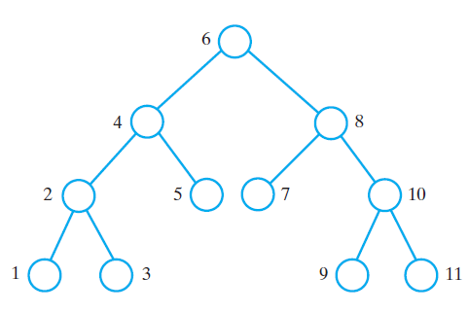
Traversals of a Binary Tree
The visitation order of an inorder traversal

Slide 32
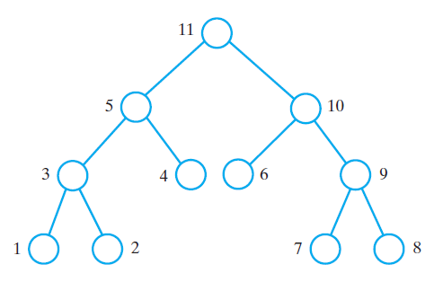
Traversals of a Binary Tree
The visitation order of a postorder traversal

Slide 33
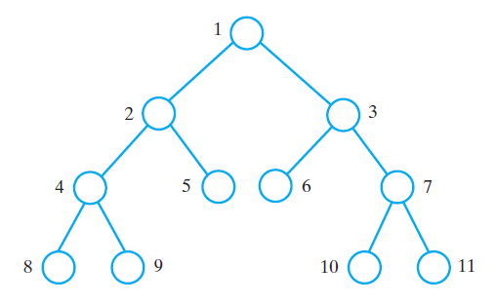
Traversals of a Binary Tree
The visitation order of a level-order traversal

Slide 34
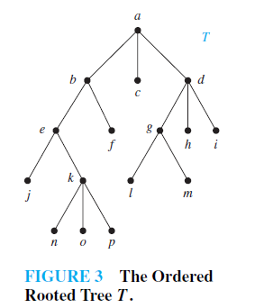
Practice
Pre-order, Post-Order, In-order

Slide 35
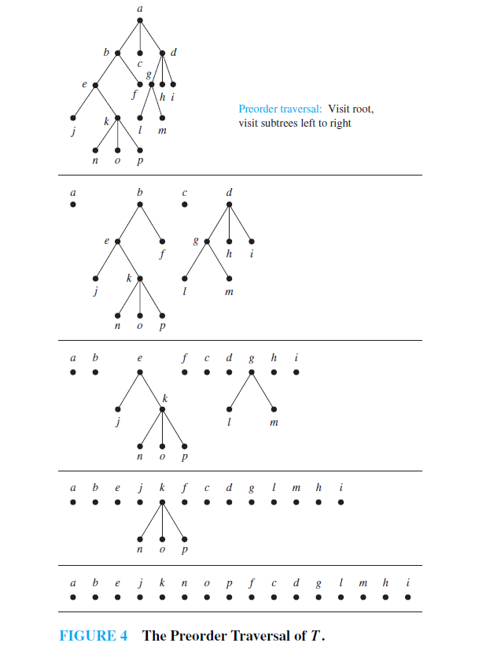

Slide 36
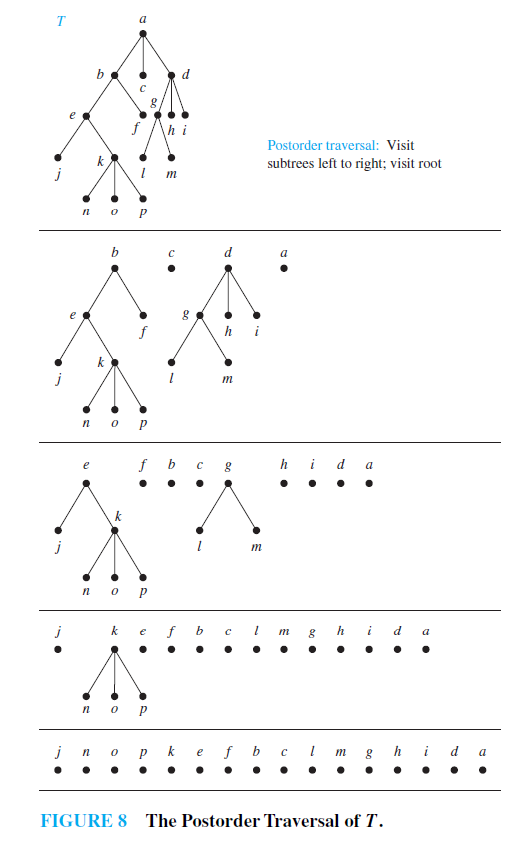

Slide 37
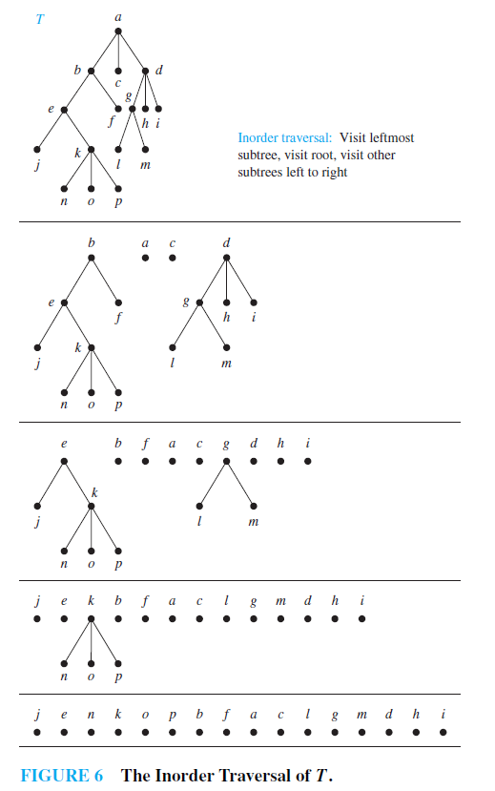

Slide 38
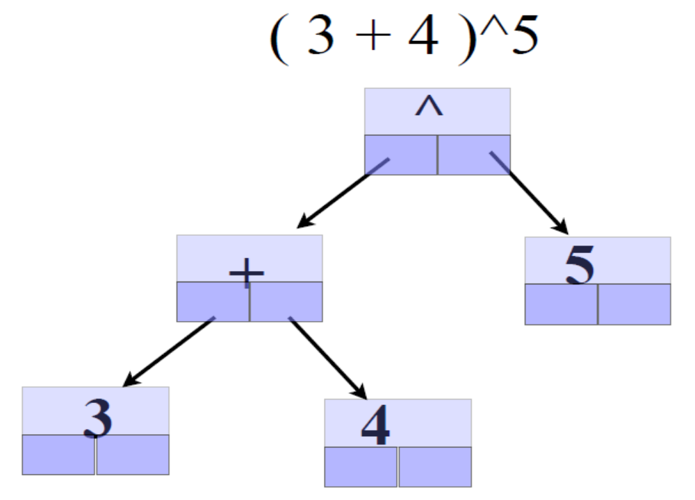
Expression Tree
Pre-order Traversal: ?
Post-order Traversal: ?
Level-order Traversal: ?
© 2013 Goodrich, Tamassia, Goldwasser
Trees
Notes:
Pre-order: ^ + 3 4 5
Post-order: 3 4 + 5 ^
In-order: 3 + 4 ^ 5
Level-order: ^ + 5 3 4
Trees

Slide 39
Print Arithmetic Expressions
Specialization of an inorder traversal
  print operand or operator when visiting node
  print “(“ before traversing left subtree
  print “)“ after traversing right subtree
Algorithm printExpression(v)
  if v has a left child
  print(“(’’)
    inOrder (left(v))
  print(v.element ())
  if v has a right child
    inOrder (right(v))
  print (“)’’)
+
×
×
2
−
3
b
((2 × (a − 1)) + (3 × b))
a
1
© 2013 Goodrich, Tamassia, Goldwasser
Trees

Slide 40
Evaluate Arithmetic Expressions
Specialization of a postorder traversal
  recursive method returning the value of a subtree
  when visiting an internal node, combine the values of the subtrees
Algorithm evalExpr(v)
  if is_leaf (v)
    return v.element ()
  else
  x ← evalExpr(left (v))
  y ← evalExpr(right (v))
  ◊ ← operator stored at v
    return x ◊ y
+
×
×
2
−
3
2
5
1
© 2013 Goodrich, Tamassia, Goldwasser
Trees

Slide 41
Simple Binary Tree
(w/o parent)
class TreeWithoutParent:
def __init__(self,element,left=None,right=None):
self._element = element
self._left = left
self._right = right
def __str__(self):
return str(self._element)
+
×
1
2
3
tree = TreeWithoutParent('+', TreeWithoutParent(1), TreeWithoutParent('*', TreeWithoutParent(2), TreeWithoutParent(3)))
© 2013 Goodrich, Tamassia, Goldwasser
Trees

Slide 42
Simple Binary Tree
(w/o parent)
def printTreePreOrder(tree):
if tree == None:
return
print(tree._element,end=" ")
printTreePreOrder(tree._left)
printTreePreOrder(tree._right)
def printTreePostOrder(tree):
if tree == None:
return
printTreePostOrder(tree._left)
printTreePostOrder(tree._right)
print(tree._element,end=" ")
+
×
1
2
3
def printTreeInOrder(tree):
if tree == None:
return
printTreeInOrder(tree._left)
print(tree._element,end=" ")
printTreeInOrder(tree._right)
© 2013 Goodrich, Tamassia, Goldwasser
Trees
Notes:
PreOrder:
+ 1 * 2 3
PostOrder:
1 2 3 * +
InOrder:
1 + 2 * 3
Trees

Slide 43
Simple Binary Tree
(with parent)
class TreeWithParent:
def __init__(self,element, parent= None, left=None, right=None):
self._element = element
self._parent = parent
self._left = left
self._right = right
def __str__(self):
return str(self._element)
left = TreeWithParent(3)
right = TreeWithParent(4)
tree = TreeWithParent(1,None,left,right)
left._parent = tree
right._parent = tree
1
3
4
© 2013 Goodrich, Tamassia, Goldwasser
Trees

Slide 44
In-class exercise time
Download simple_Tree_without_parent_in_class_student.py from Brightspace.
Create expression tree for 3*2 + 5-2
Complete the PreOrderTraversal(tree), PostOrderTraversal(tree) & InOrderTraversal(tree) functions.
Upload your solution to Gradescope
Trees

Slide 45
Tree ADT
We use abstract nodes
Generic methods:
  Integer len()
  Boolean is_empty()
  Iterator nodes()
  Iterator iter()
Accessor methods:
  node root()
  node parent(node)
  Iterator children(node)
  Integer num_children(node)
Query methods:
  Boolean is_leaf(node)
  Boolean is_root(node)
Update method:
  element replace (p, o)
Additional update methods may be defined by data structures implementing the Tree ADT
© 2013 Goodrich, Tamassia, Goldwasser
Trees

Slide 46
BinaryTree ADT
The BinaryTree ADT extends the Tree ADT, i.e., it inherits all the methods of the Tree ADT
Additional methods:
  node left(node)
  node right(node)
  node sibling(node)
Update methods may be defined by data structures implementing the BinaryTree ADT
© 2013 Goodrich, Tamassia, Goldwasser
Trees

Slide 47
Linked Structure for Trees
A node is represented by an object storing
  Element
  Parent node
  Sequence of children nodes
∅
B
∅
∅
A
D
F
B
A
D
F
C
E
∅
∅
C
E
© 2013 Goodrich, Tamassia, Goldwasser
Trees

Slide 48
Linked Structure for Binary Trees
A node is represented by an object storing
  Element
  Parent node
  Left child node
  Right child node
∅
B
∅
∅
B
A
D
A
D
∅
∅
∅
∅
C
E
C
E
© 2013 Goodrich, Tamassia, Goldwasser
Trees

Slide 49
Array-Based Representation of Binary Trees
Nodes are stored in an array A
1
A
A
B
D
…
G
H
…
2
3
0
1
2
3
10
11
B
D
Node v is stored at A[rank(v)]
  rank(root) = 1
  if node is the left child of parent(node), rank(node) = 2 ⋅ rank(parent(node))
  if node is the right child of parent(node), rank(node) = 2 ⋅ rank(parent(node)) + 1
4
5
6
7
E
F
C
J
10
11
G
H
© 2013 Goodrich, Tamassia, Goldwasser
Trees

Slide 50
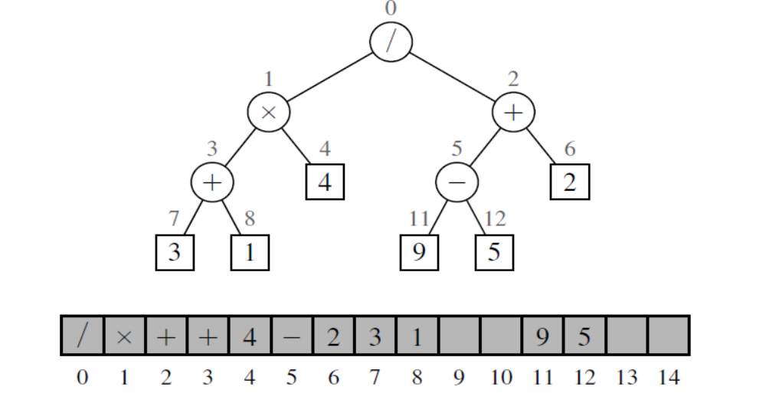
Example of using Lists to present Binary Tree
© 2013 Goodrich, Tamassia, Goldwasser
Trees
Notes:
Trees

